Slide 1
Python by smell
Advanced Python constructs for scientists
Pietro Berkes, Nagra Insight

Slide 2
What’s this smell?
Scientists in the wild tend to write this…
You’re here because you started feeling the “code smell” (a technical term)
I can show you that you already have the instinct: what is wrong with Matthieu’s code?
Notes:
~/n/MatthieuHarbich/nagra_git/thesis/generative Open Generative%20model%20-%20Mixture%20of%20gaussians_EM_markovModels_soft_clustering-plotLH-C%2BCLEAN-LH_TEST-4k-Copy1.ipynb
Then open any other with similar nale
It smells like you need a Python module

Slide 3
What’s this smell?
What about this smell?
Here repetitive code -> it’s the smell of functions

Slide 4
What is wrong with smelly code?
Redundant, not flexible: an update in one place would need to be duplicated everywhere
Hard to test: the code that performs the interesting computation is mixed with the code that does the repetitive boilerblate

Slide 5

Objective
This is a code smell detection crash course for scientific programming
Advanced Python constructs are made to get rid of the smell!
These constructs are not very common in scientific code, and you don’t actually ”need” them. But the same is true for functions…

Slide 6
All the smells
The smell of generators
The smell of decorators
for ... :
# Transform / filter
for ... :
# Transform / filter
# The interesting part of the code
def my_function(x, y, z):
# Common boilerplate
# Function-specific part
# Common boilerplate
The smell of context managers
The smell of classes
# Prepare
try:
# The code you care about
finally:
# Clean up
def first_function(x, y, z):
# Something
def second_function(x, y, z):
# Something else
def third_function(x, y, z):
# Something more

Slide 7
The smell of generators
One or more nested loops, variables over which one iterates requires some extra transformation or filtering
for ... :
# Transform / filter
for ... :
# Transform / filter
# The interesting part of the code
This is the part that actually does some interesting computation. At the moment, it’s hard to test it!
… becomes …
for ... in my_generator():
# The interesting part of the code

Slide 8
The smell of context managers
Before executing the code, something needs to happen: open a file, connect to a DB, initialize some hardware
# Initialize context
try:
# The code you care about
finally:
# Clean up context
Once the code has executed, we need to clean up, even if an error occurred: close the file, commit / revert SQL transactions, disconnect from hardware
… becomes …
with my_context_manager():
# The code you care about

Slide 9
The smell of decorators
Boilerplate code at the start and/or end of functions.
Typical cases: logging, deprecation, conditions checks, caching
def my_function(x, y, z):
# Boilerplate at start
# Function-specific part
# Boilerplate at end
This is the part that is specific to what the function actually does
… becomes …
@my_decorator
def my_function(x, y, z):
# Function-specific part

Slide 10
The smell of classes
def first_function(x, y, z):
# Something
def second_function(x, y, z):
# Something else
def third_function(x, y, z):
# Something more
The same set of parameters is needed for a set of functions. In code calling this function, one needs extra code to keep these parameters in sync.
… becomes …
def first_function(xyz):
# Something
def second_function(xyz):
# Something else
def third_function(xyz):
# Something more
class Xyz:
def __init__(self, x, y, z):
...

Slide 11
One smell at the time… generators first

Slide 12
The smell of generators
One or more nested loops, variables over which one iterates requires some extra transformation or filtering
for ... :
# Transform / filter
for ... :
# Transform / filter
# The interesting part of the code
This is the part that actually does some interesting computation. At the moment, it’s hard to test it!
… becomes …
for ... in my_generator():
# The interesting part of the code

Slide 13
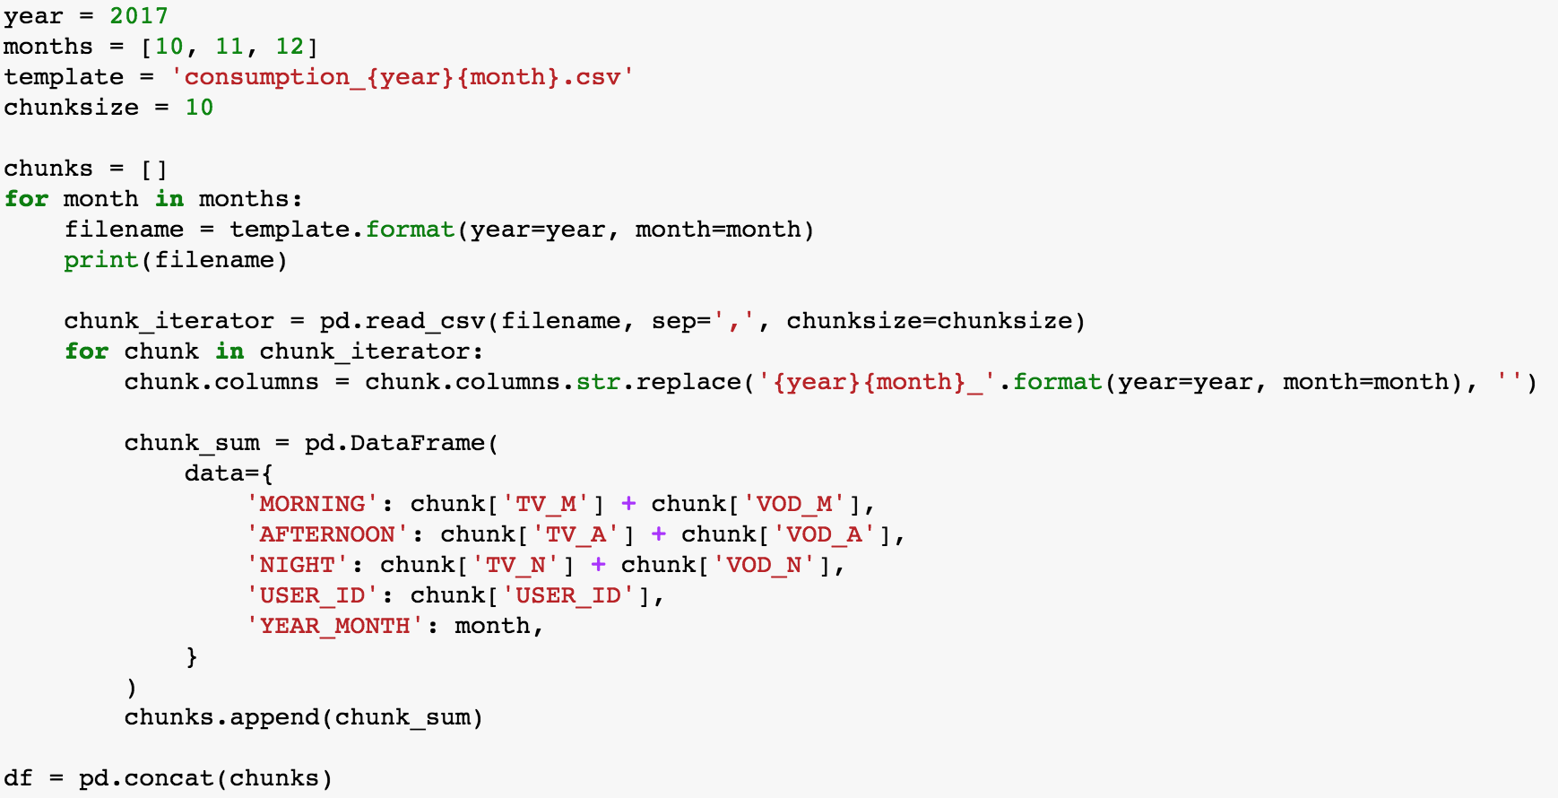
Example
Explain context…
Needed to do this for different years, with different computations
Testing this thing will require creating fake, messy files <- this is a complicated point to make, with a generator it requires mocking it…

Slide 14
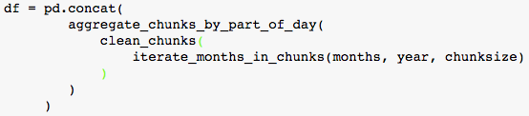
Ideally…
This is actually what we’d like to write.
All of this without actually loading all the data in memory for the intermediate steps!
Before getting here this we need to do a step back…

Slide 15
Go to “generators” notebooks

Slide 16
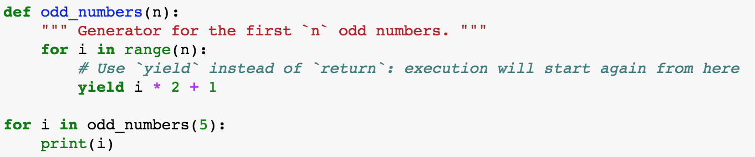
Recap: Generators
Generators are used to get rid of repetitive loops, often nested ”for” loops followed by filtering of the data
Generators return one item at the time, the list of items does not need to be in memory
A generator is defined as a function containing the keyword ”yield”:

Slide 17
One smell at the time… classes (an introduction)

Slide 18
The smell of classes
def first_function(x, y, z):
# Something
def second_function(x, y, z):
# Something else
def third_function(x, y, z):
# Something more
The same set of parameters is needed for a set of functions. In code calling this function, one needs extra code to keep these parameters in sync.
… becomes …
def first_function(xyz):
# Something
def second_function(xyz):
# Something else
def third_function(xyz):
# Something more
class Xyz:
def __init__(self, x, y, z):
...

Slide 19
Go to “classes” notebooks

Slide 20
Class structure summary
Constructor, attribute, methods, class method (e.g. class factory)

Slide 21
What belongs to a class?
Belongs:
Data that always belongs together: better create several simple classes than one class that contains everything
Methods to load/save data, create data in different ways (factory methods)
Methods to update parameters
Does not belong:
Methods to visualize data: Model-View pattern. You will want to visualize the data in many different ways, better have separate utility visualization functions that take one of the instances as input and visualize them.

Slide 22
Another smell of classes
Many classes with the same structure
Example: sklearn

Slide 23
One smell at the time… Context managers

